Slide 1
The Future
Yu Shao
GAM 631: Portfolio and Thesis Prep
5th Semester / 3rd Year

Slide 2
Statement of Professional Goals

Slide 3
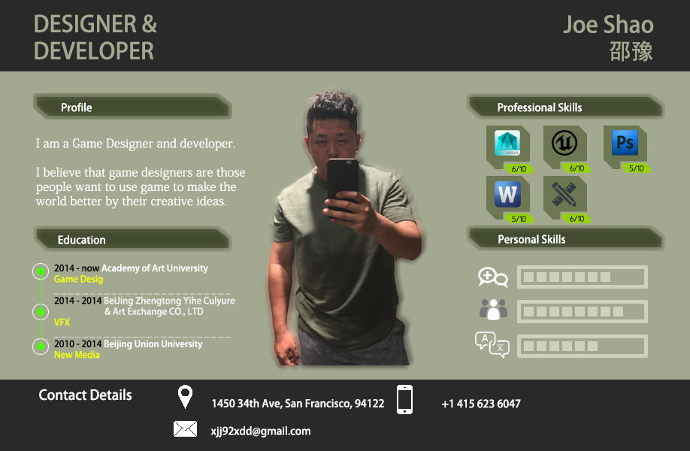

Slide 4
Portfolio Samples

Slide 5
Portfolio Samples, cont.

Slide 6
Abstract
An open world MMO-RPG game that allows you to create the future and become the history.
The core element of The Future is the development the character and the world. We see the designer of the game as the creater of the rules, then the player of this game is the designer of the game world. All the future of the game is influenced by the descision of the game player.

Slide 7
Rationale
The most important reason I want to make this game is I found that the descision of the player was never influenced to the game world before. So I want to make something new and can be remembered. On the other hand, the fact is I had never make such a big game before, and I know there are so many things I can learn from this game.

Slide 8

Inspiration: Skyrim
Skyrim is really good example of the open world game. The design team provided an exquisite talent-tree system and some magnificent story lines. They provide an objective degree of freedom and the player's influence on the game world.

Slide 9
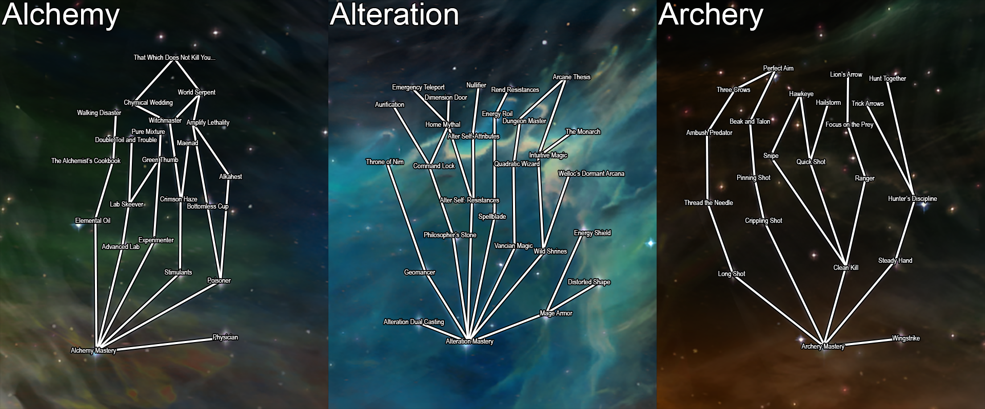
Inspiration: Skyrim
Same as Skyrim, in The Future player can build their own talent tree in their own will. But something interesting will happened is after they choose the new talent their character appearance will also changed by the choice.

Slide 10

Inspiration: MineCraft
MineCraft is another real good example of the open world game. Player can build their own world by the game. What I want to do is to build a world can be influenced by the player in some way, not only the world’s look like but also the story and future.

Slide 11
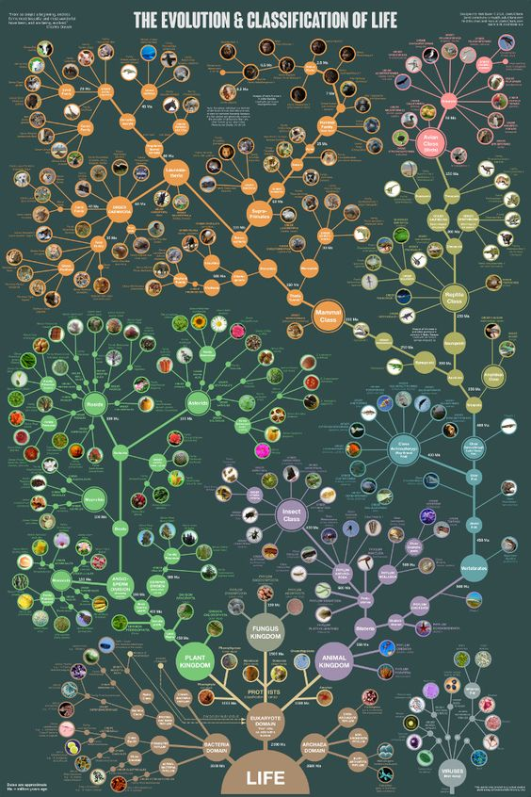
Skill Tree Reference
Different choice will make different change.
Different change point to different result.

Slide 12
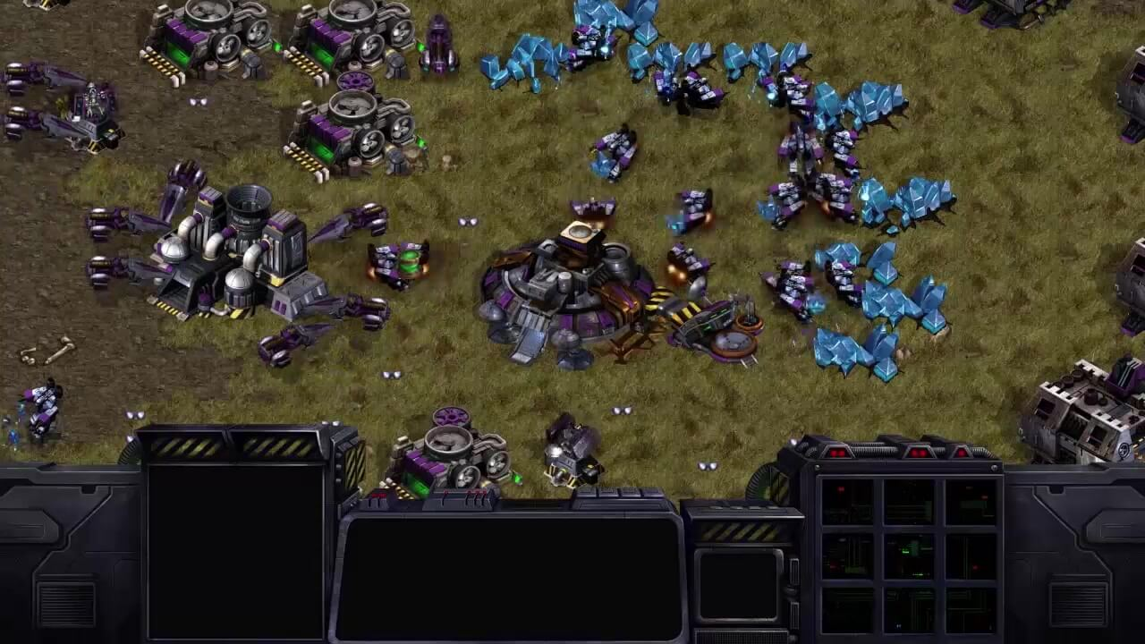
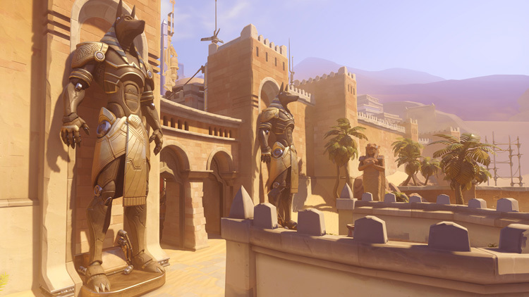
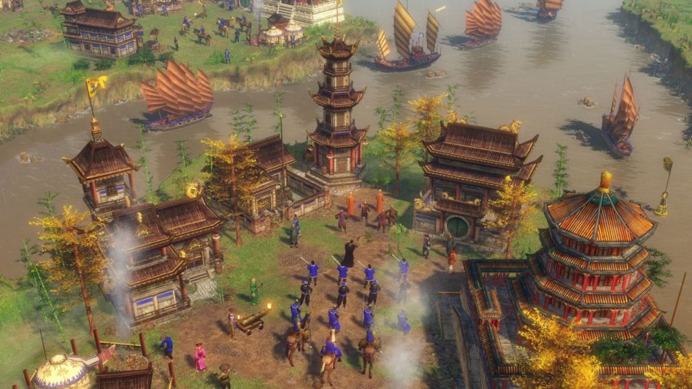
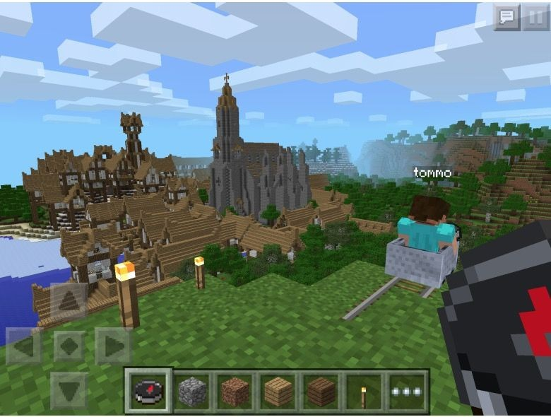
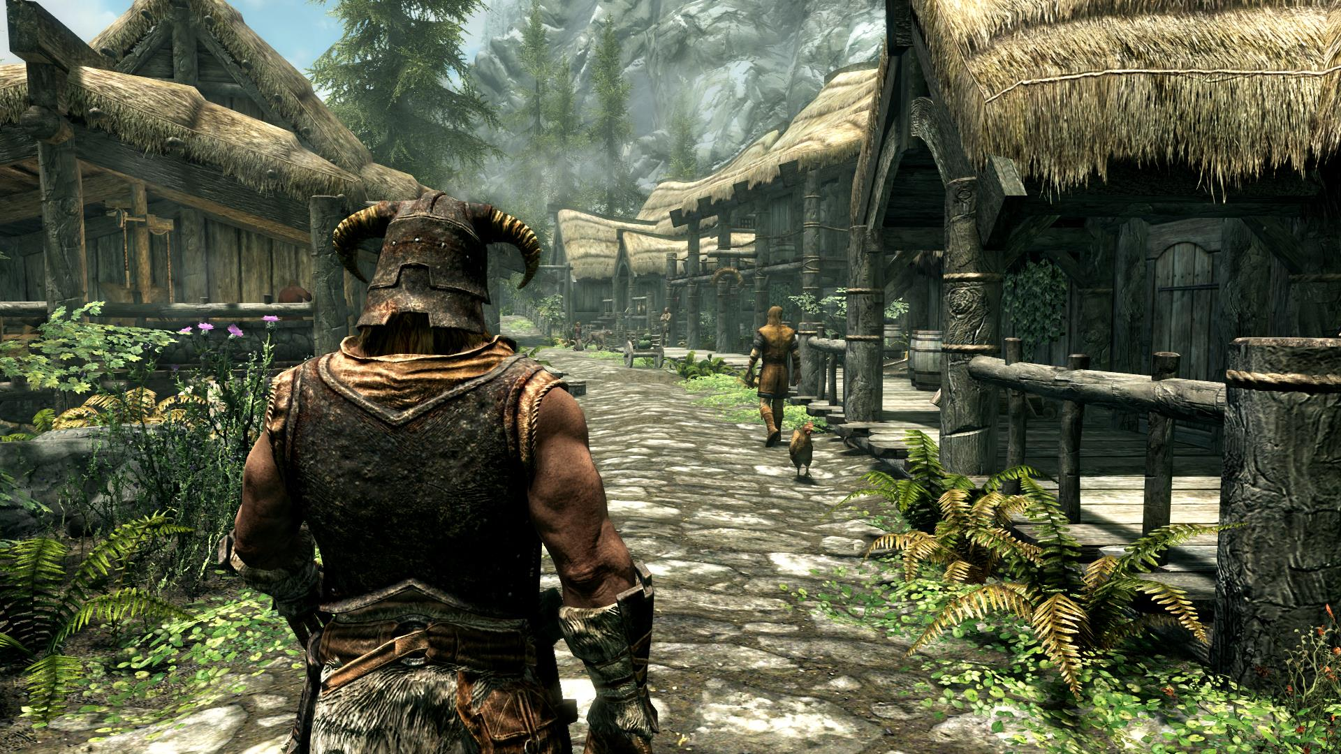
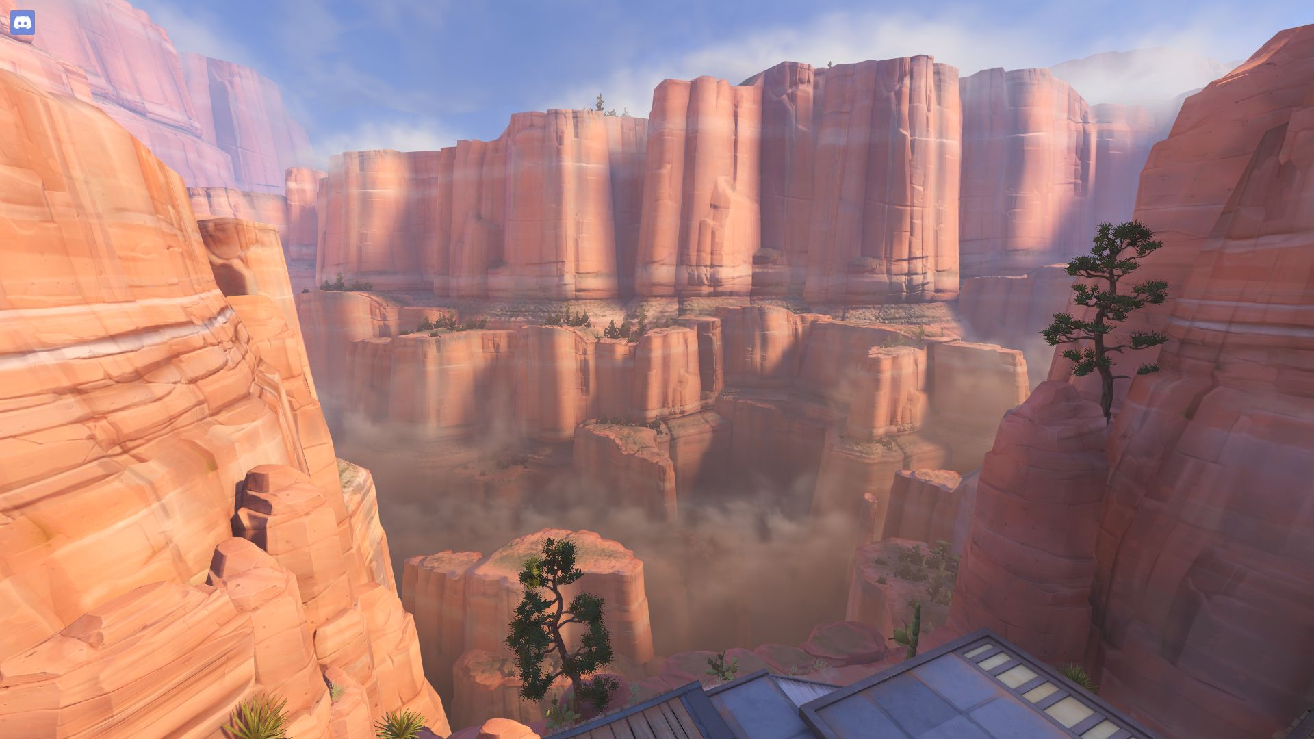
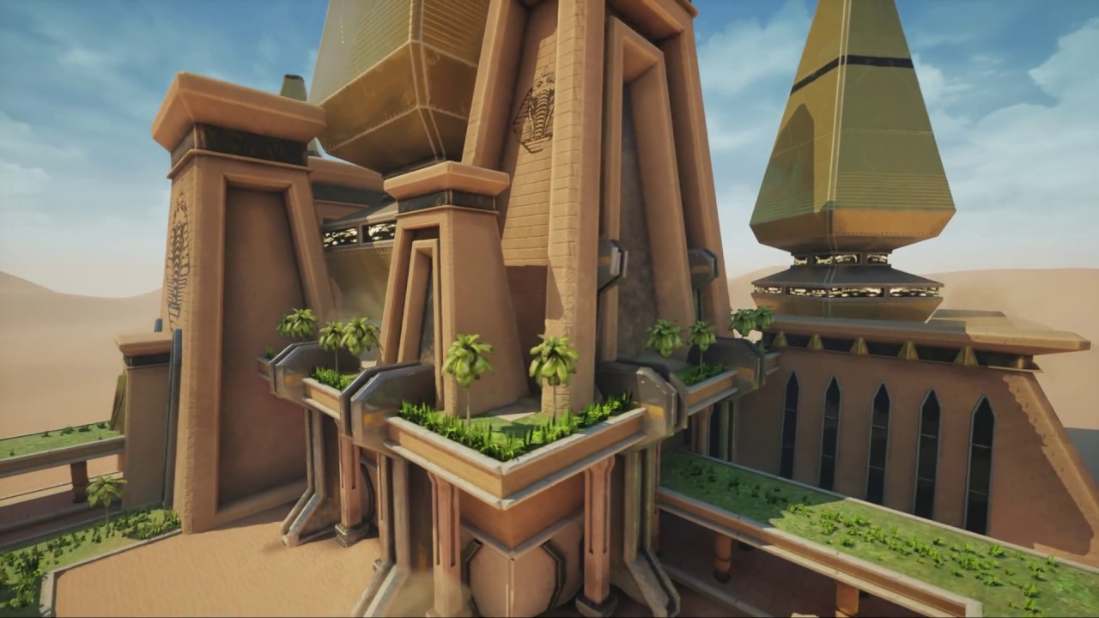

Slide 13
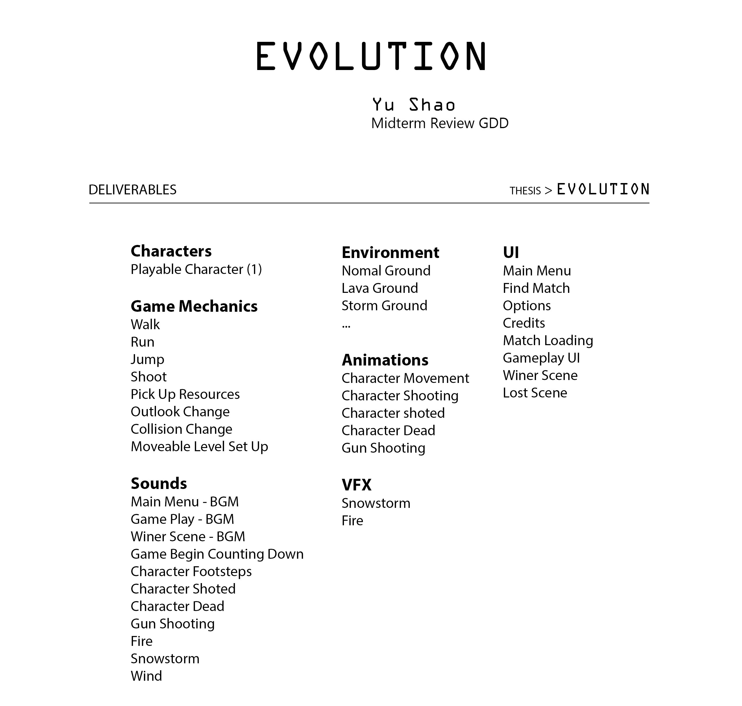

Slide 14
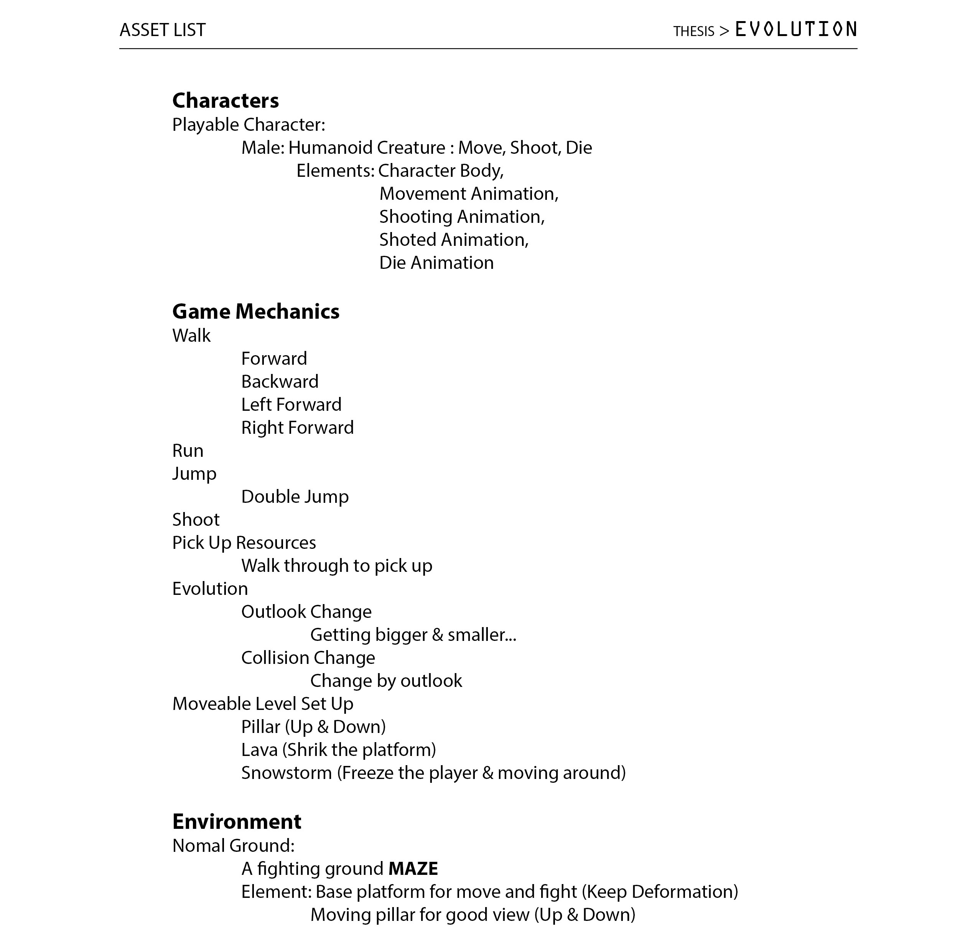

Slide 15
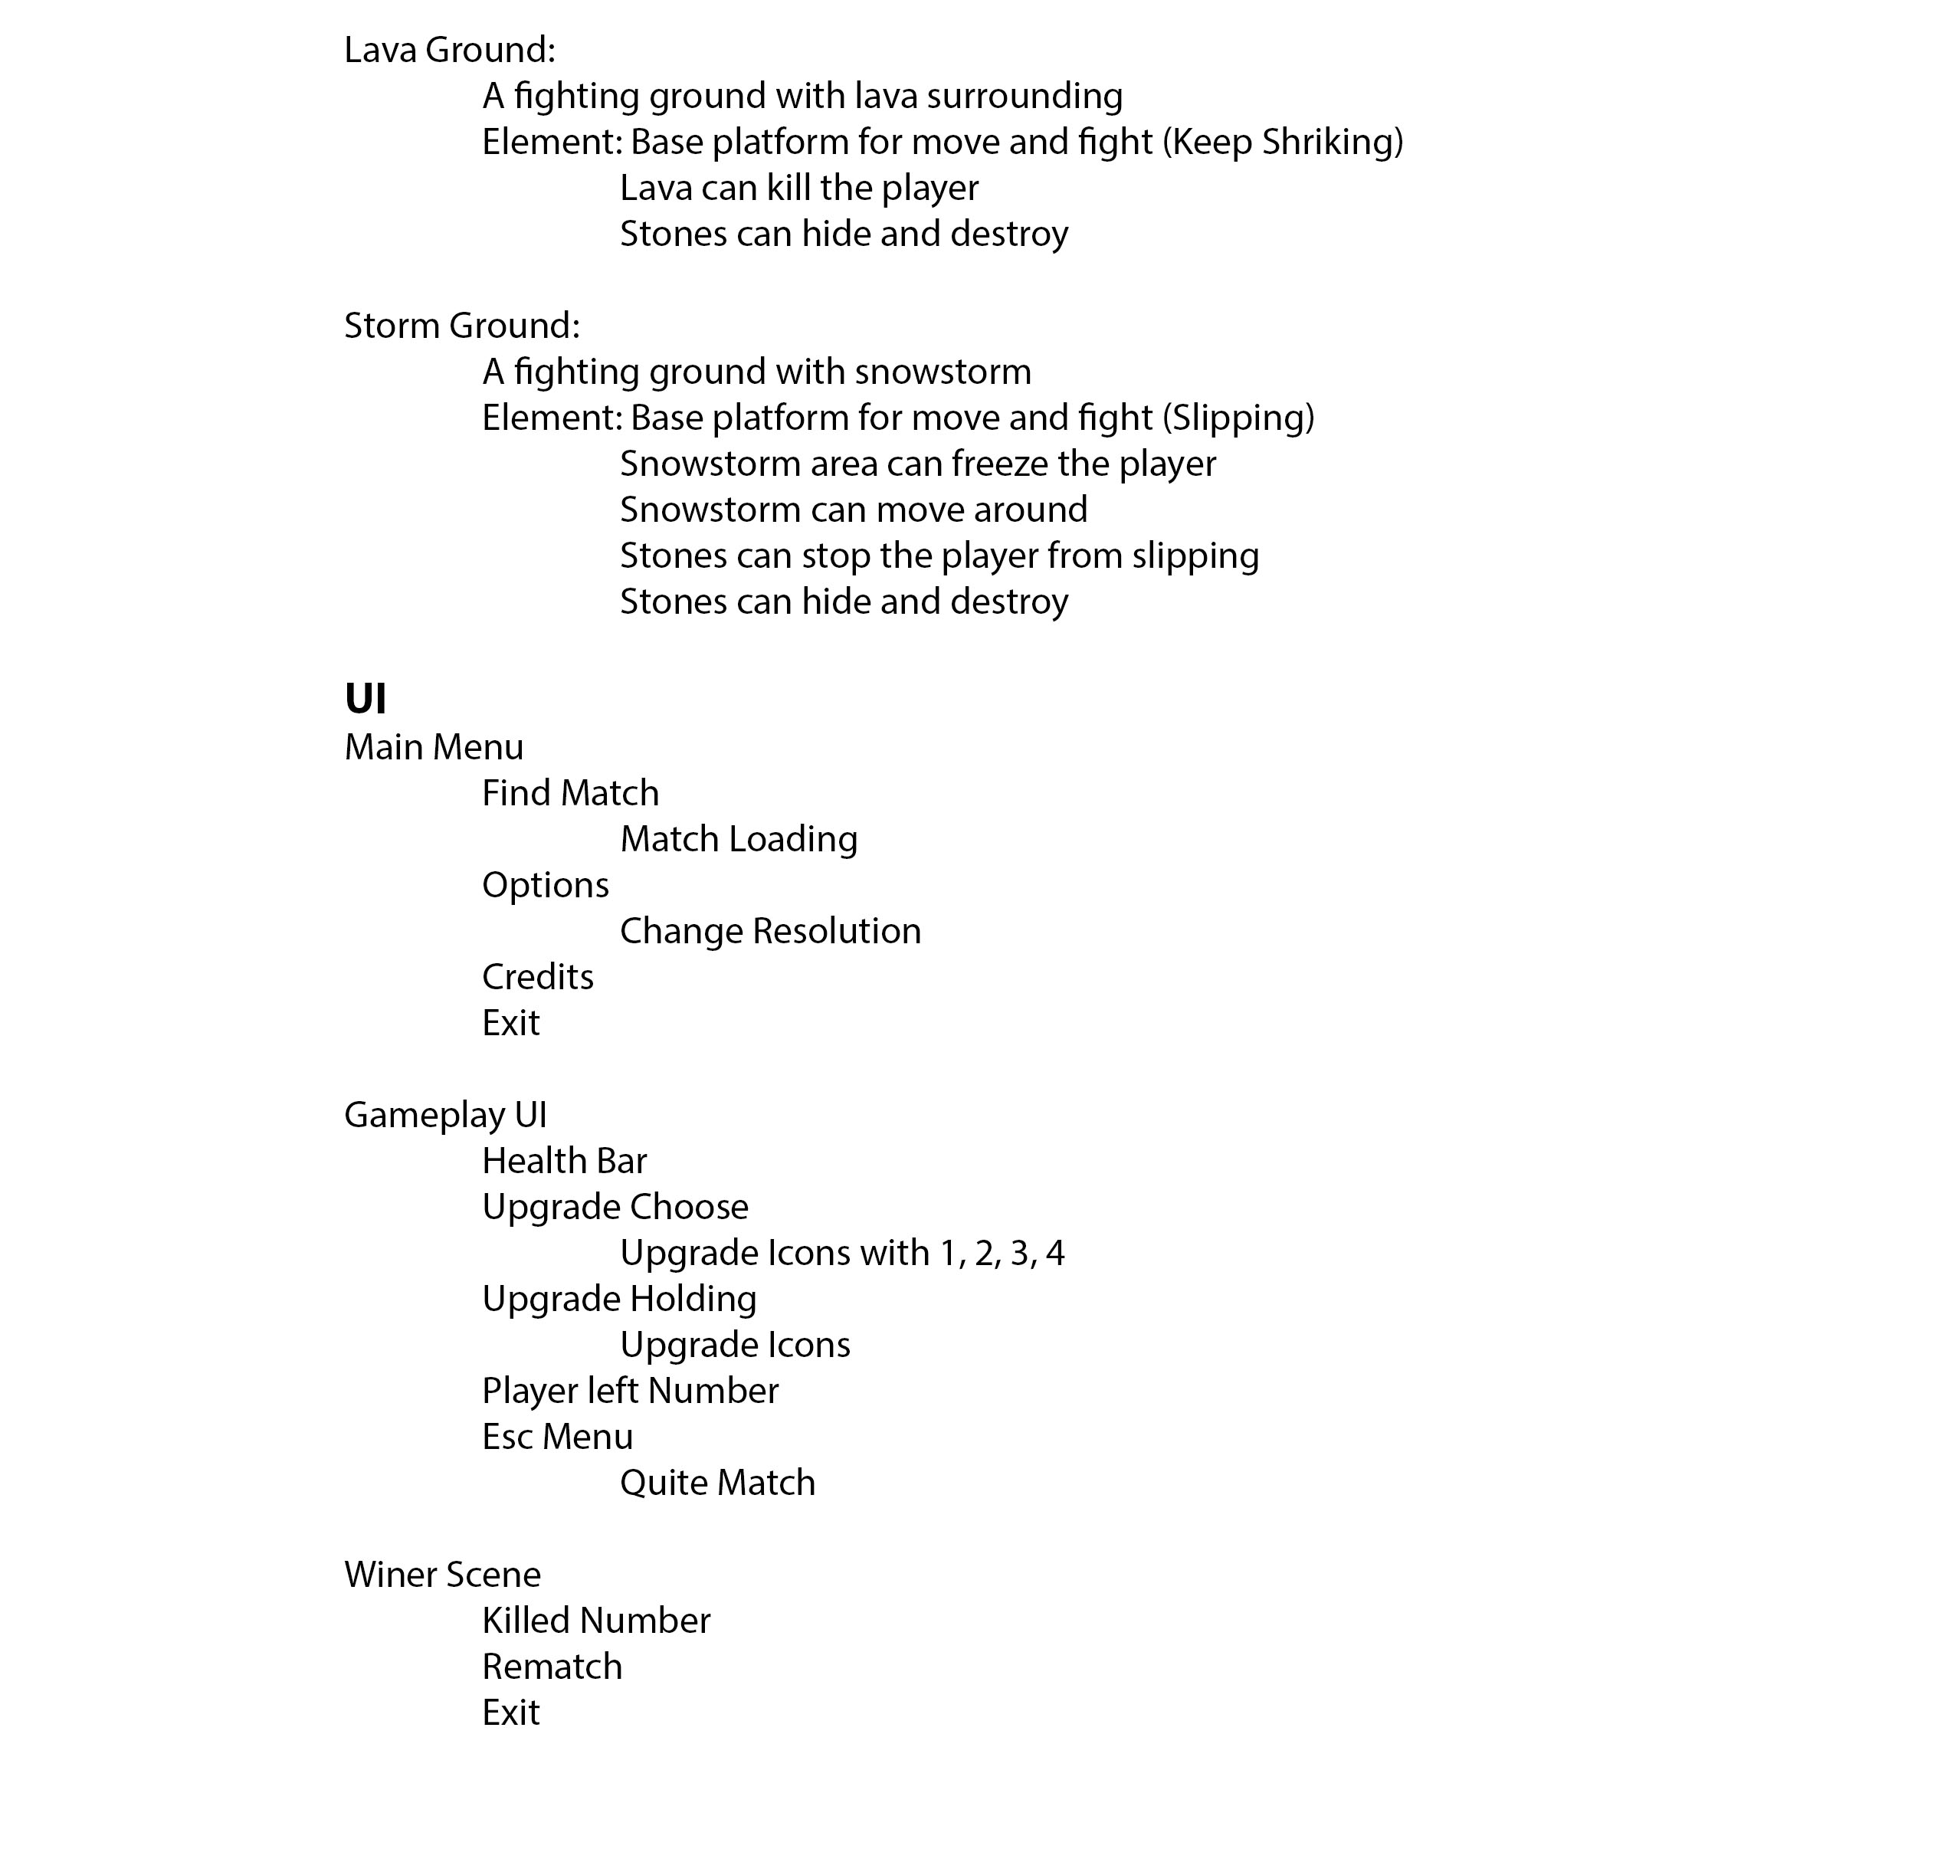

Slide 16
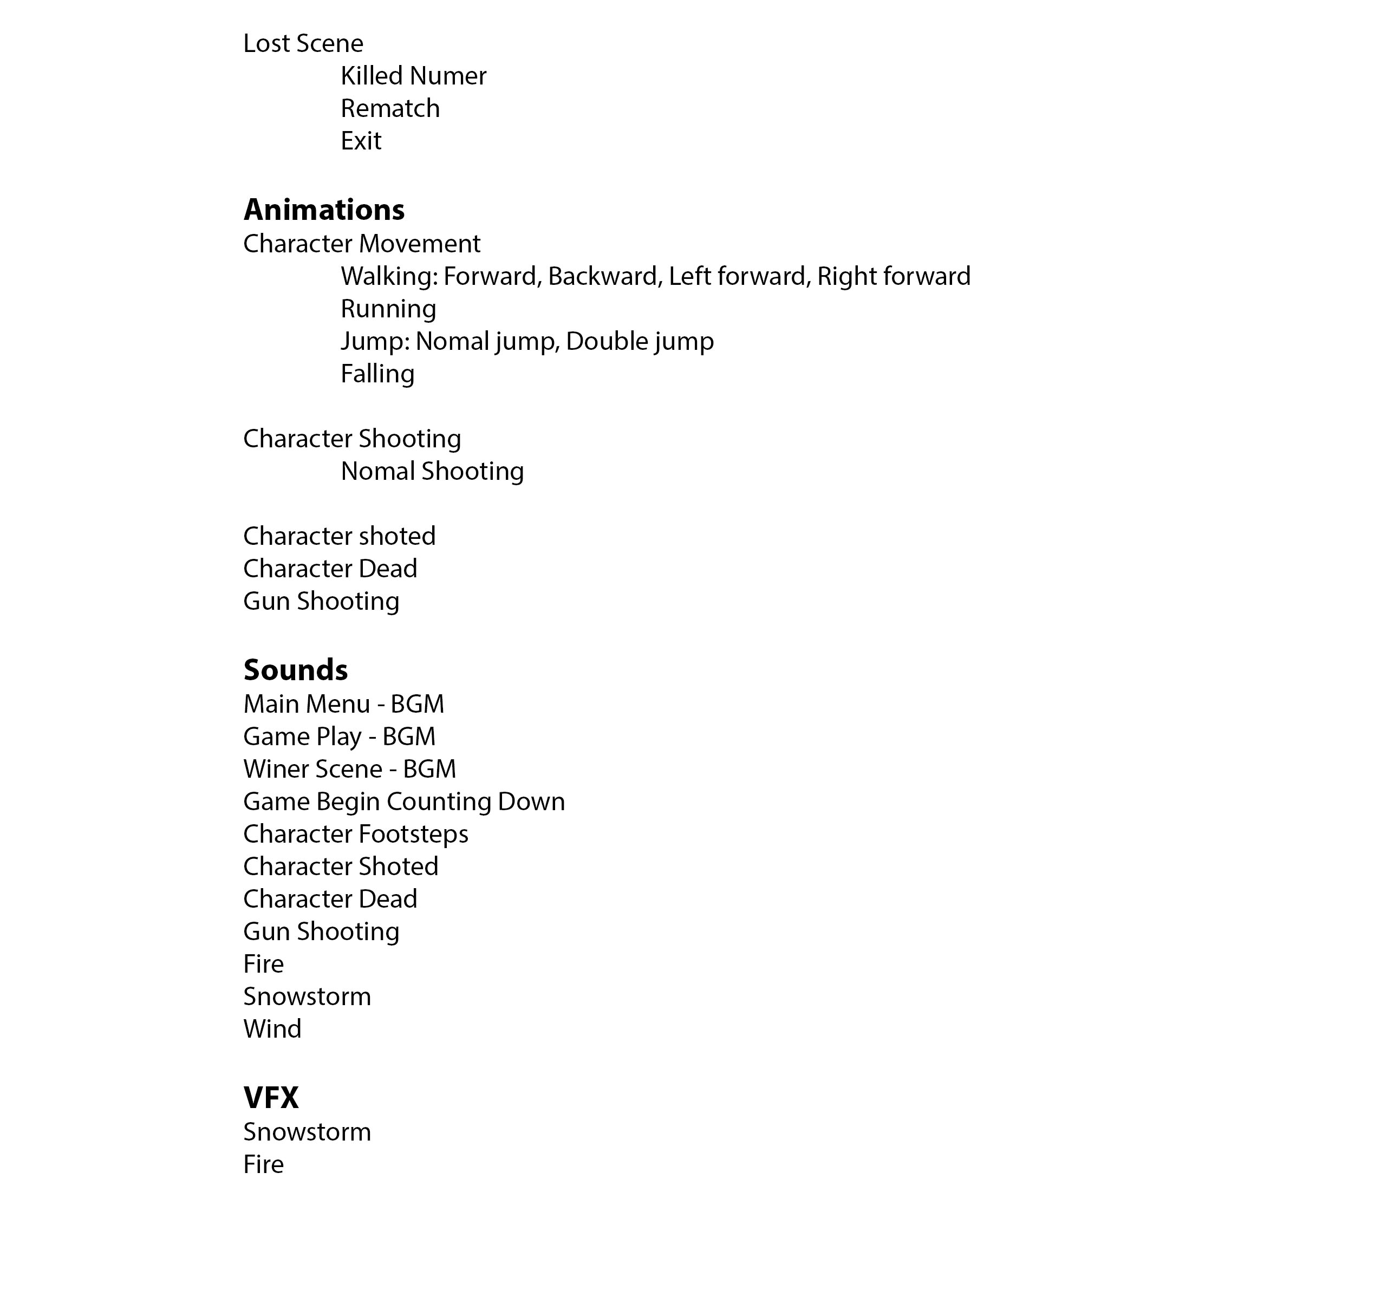

Slide 17
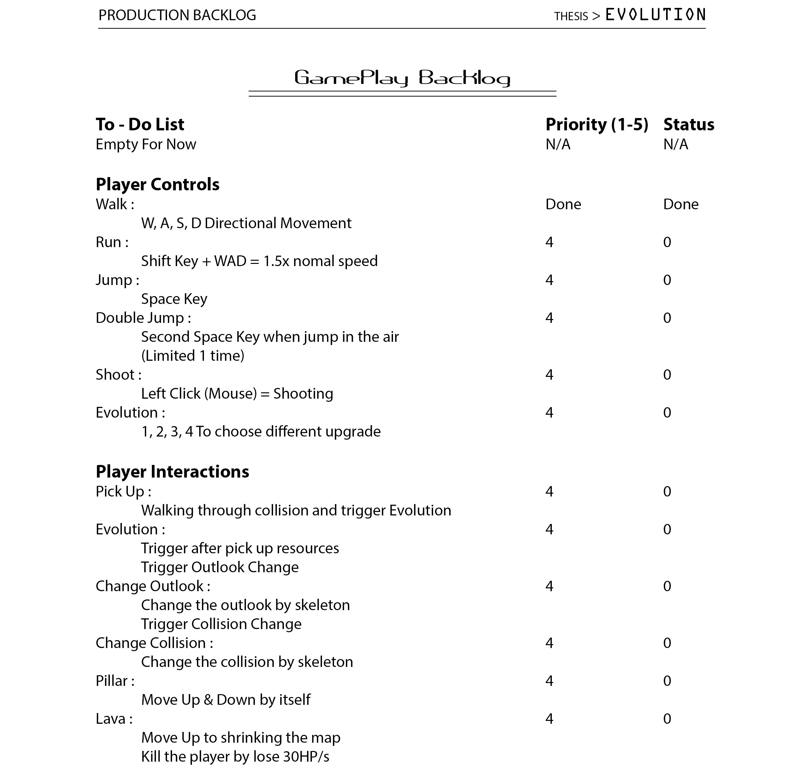

Slide 18
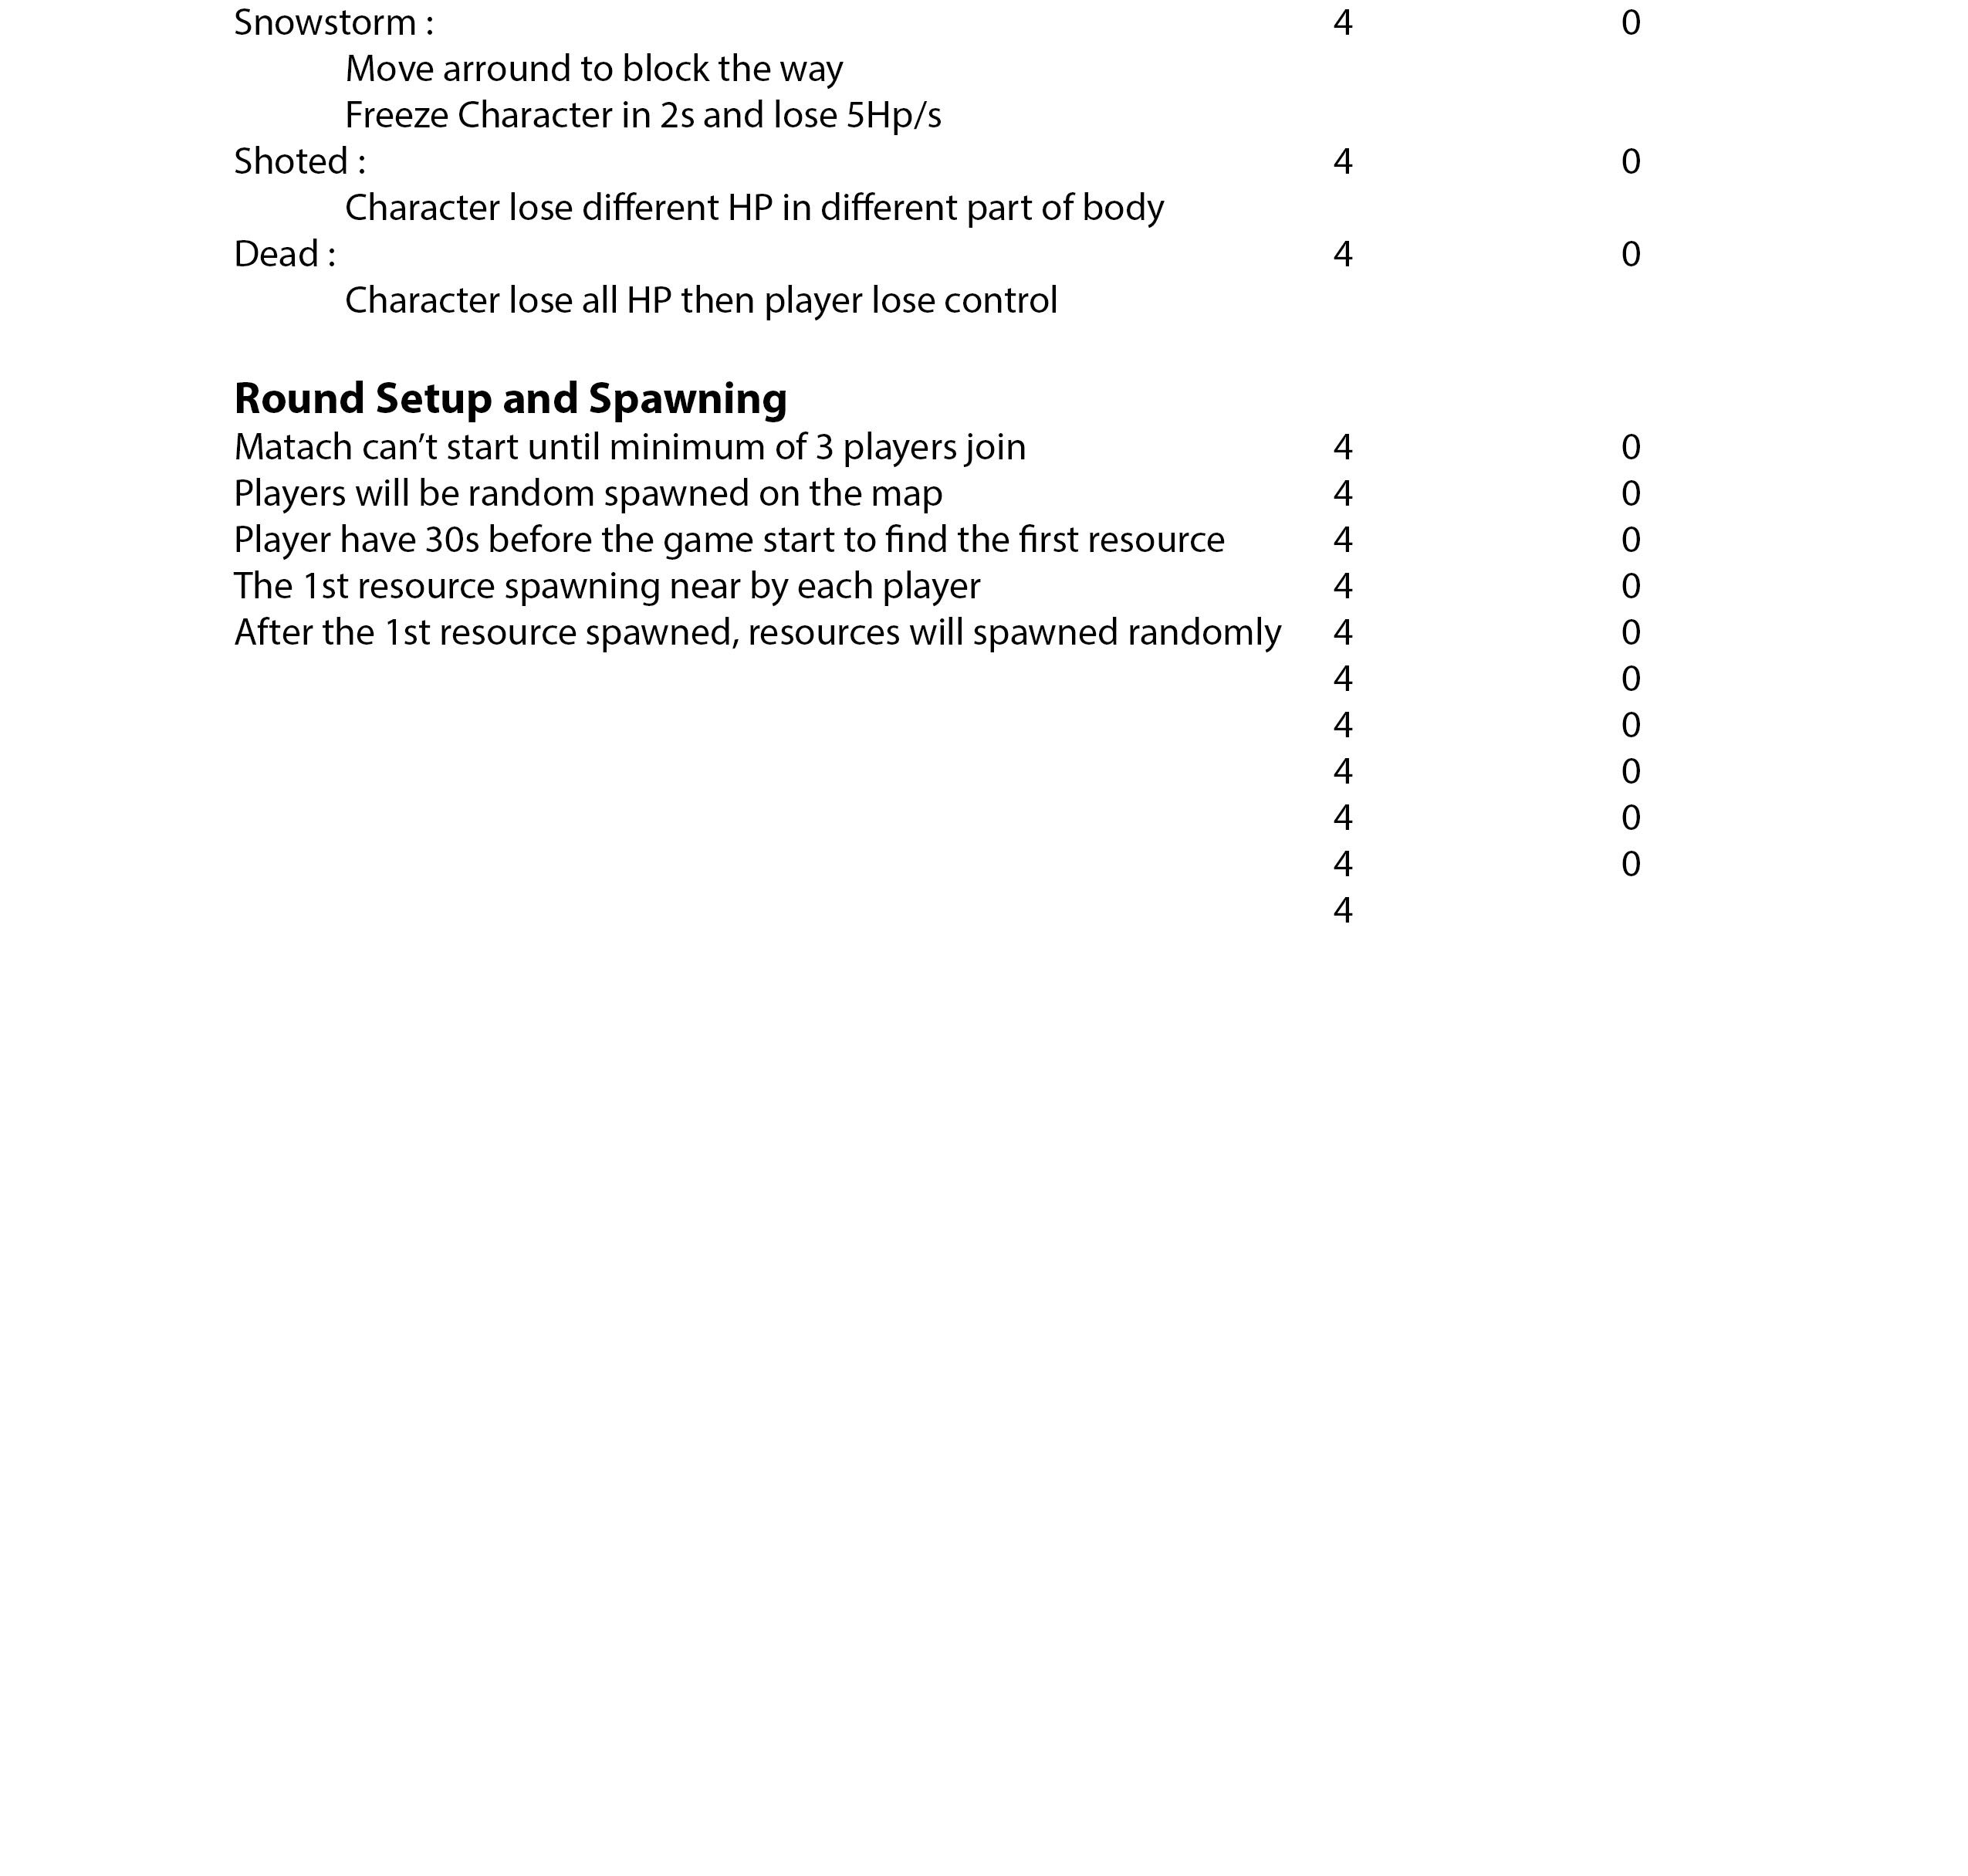

Slide 19
Midpoint Thesis Project Proposal

Slide 20
Project Timeline / Milestones / Gantt Chart

Slide 21
Course Timeline

Slide 22
Areas of Concern

Slide 23
Thank You!

